Slide 1


Program: Heritage Grants

Slide 2
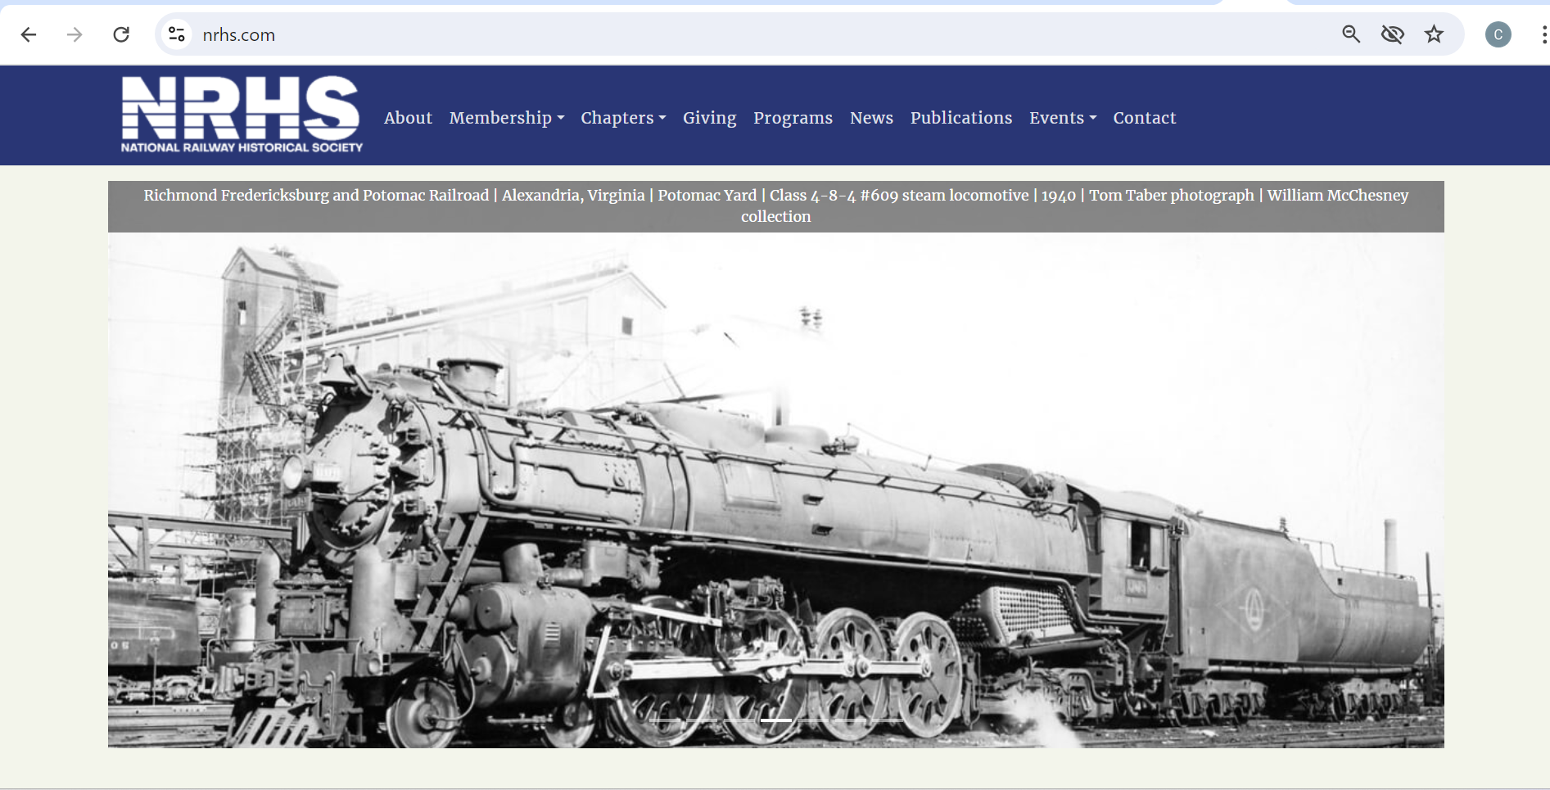

Slide 3
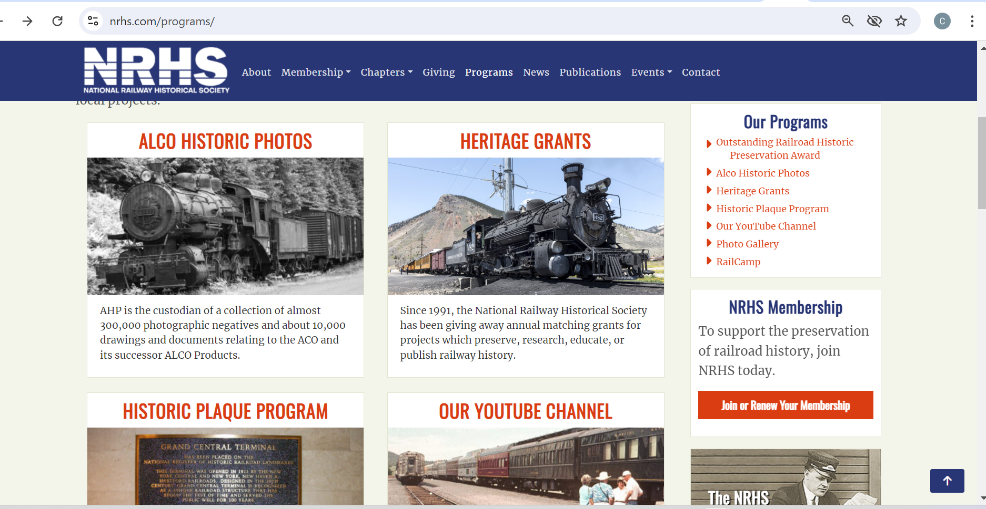

Slide 4
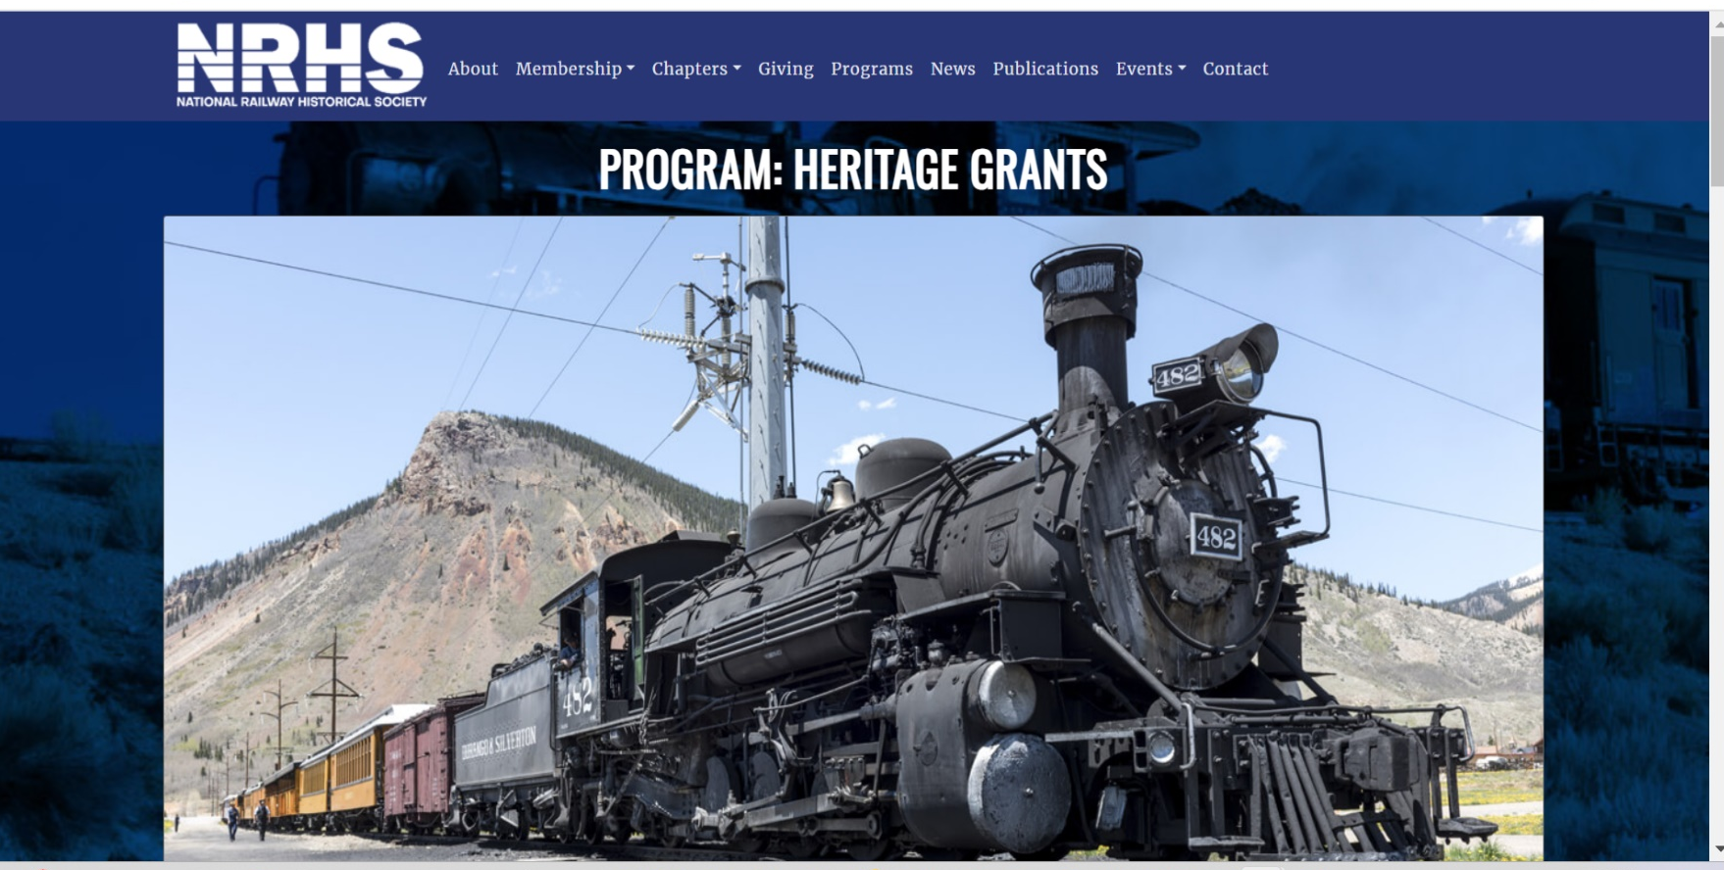

Slide 5
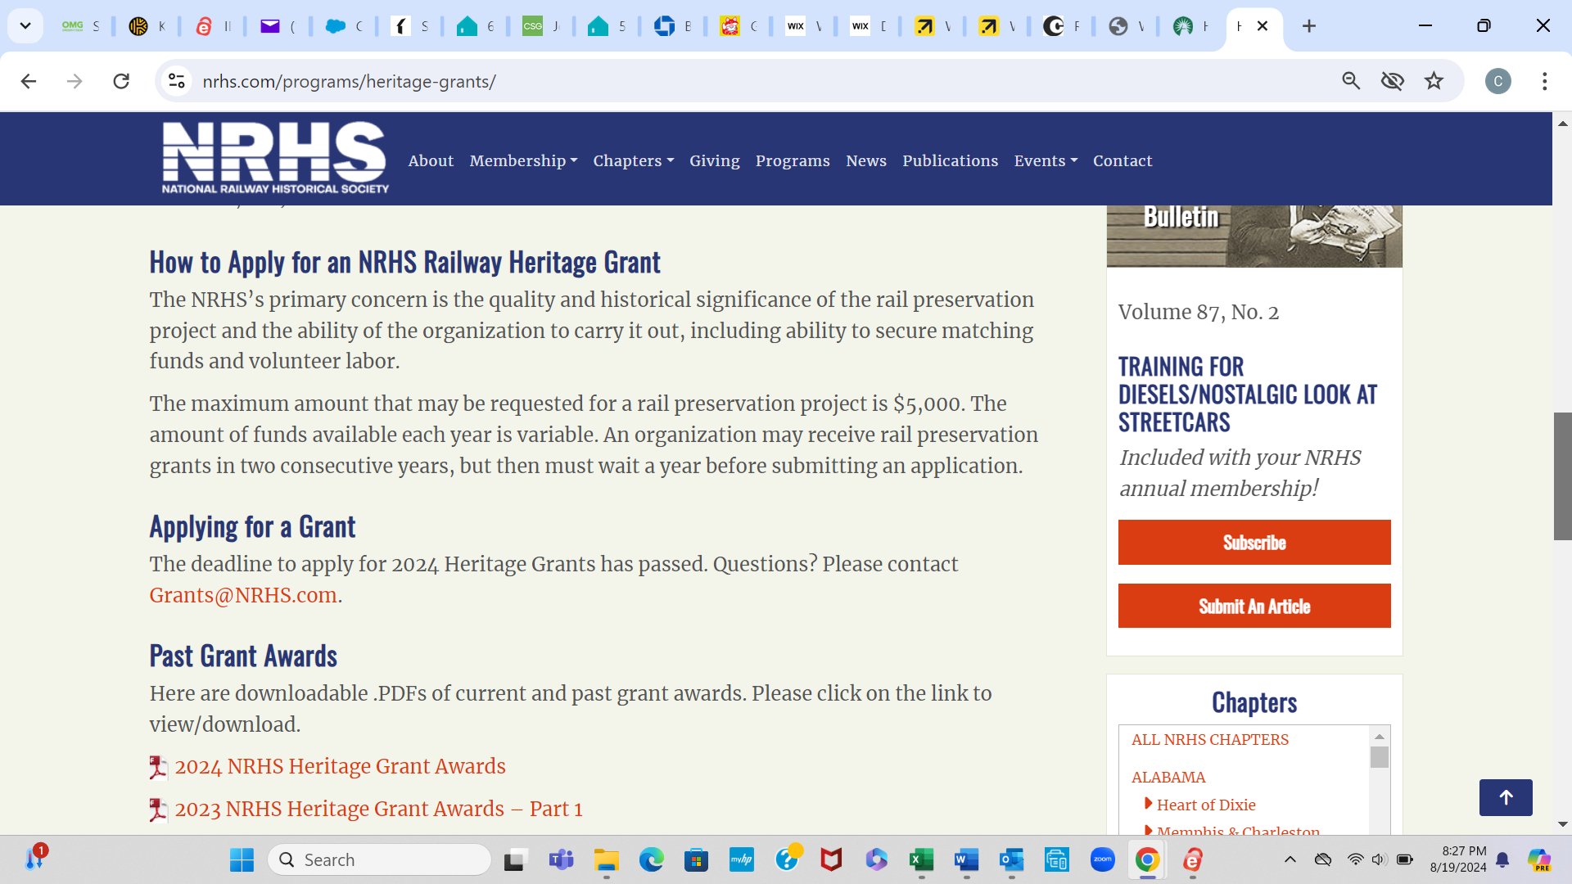

Slide 6
Listing of NRHS Heritage Grants from NRHS Website
2024 NRHS Heritage Grant Awards
2023 NRHS Heritage Grant Awards – Part 1
2023 NRHS Heritage Grant Awards – Part 2
2022 NRHS Heritage Grant Awards
2021 NRHS Heritage Grant Awards
2020 NRHS Heritage Grant Awards
2019 NRHS Heritage Grant Awards
2018 NRHS Heritage Grant Awards
2017 NRHS Heritage Grant Awards
2016 NRHS Heritage Grant Awards
2015 NRHS Heritage Grant Awards
2014 NRHS Heritage Grant Awards
2013 NRHS Heritage Grant Awards
2012 NRHS Heritage Grant Awards
2011 NRHS Heritage Grant Awards

Slide 7
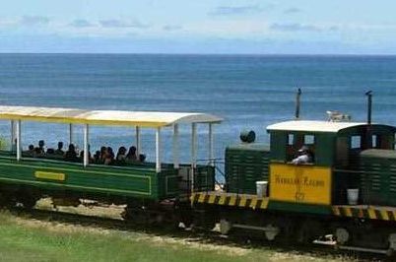
$3,000 to the Hawaiian Railway Society in 2020
With the generous support of its members, donors and organizations such as the NRHS, the HRS, as part of a larger rail yard development project including a replica OR&L Station and a covered rolling stock storage and display facility, will soon break ground on a new museum structure designed to resemble an early 20th century OR&L freight building.

Slide 8
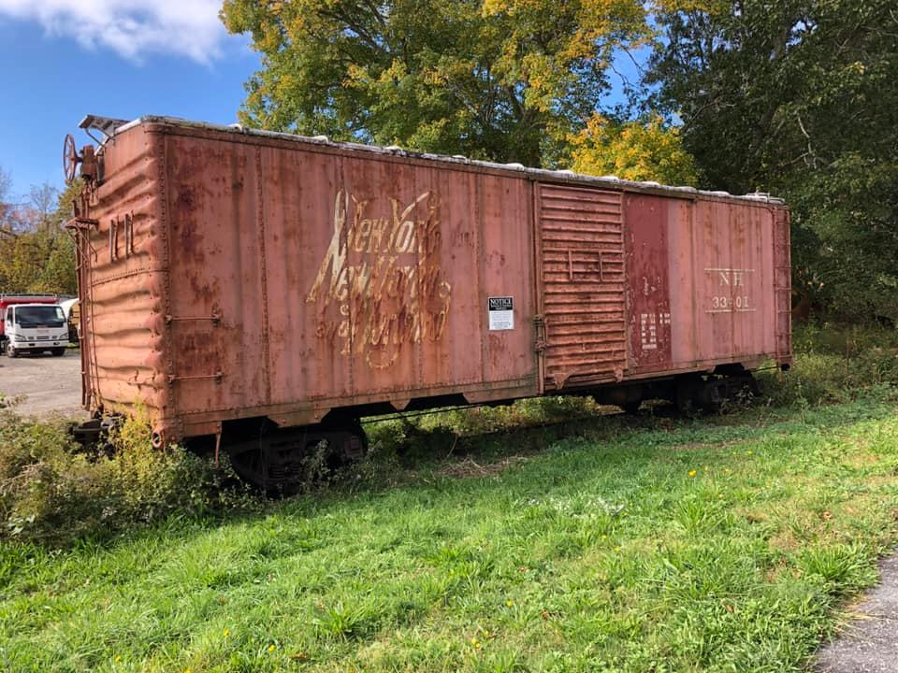
Cape Cod Chapter,
2020 Grant
Cape Cod Chapter NRHS received an $1800.00 grant from the National Railway Historical Society Heritage Grants for the restoration of an old New Haven Railroad boxcar. Cape Cod Chapter, NRHS has matching grant funds set aside.

Slide 9
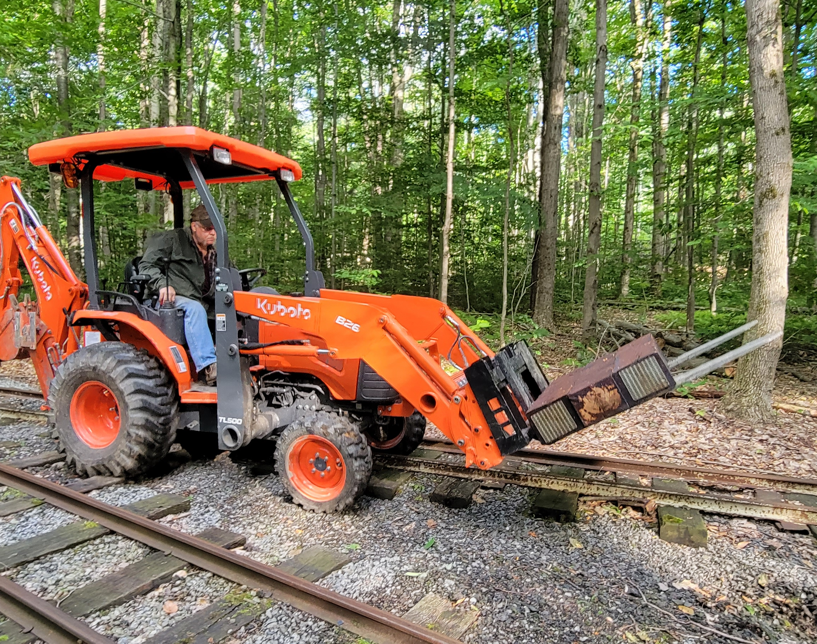
Bucksgahuda and Western Railroad,
2021 Grant
The Bucksgahuda and Western Railroad Co., a 501C3 Corporation is pleased to announce that the $5,000 Heritage Grant, from the National Railway Historical Society, has been used to help purchase a new Kubota B26TLB. This purchase allows us to have a backhoe again as our original one of 22 years was beyond repair.

Slide 10
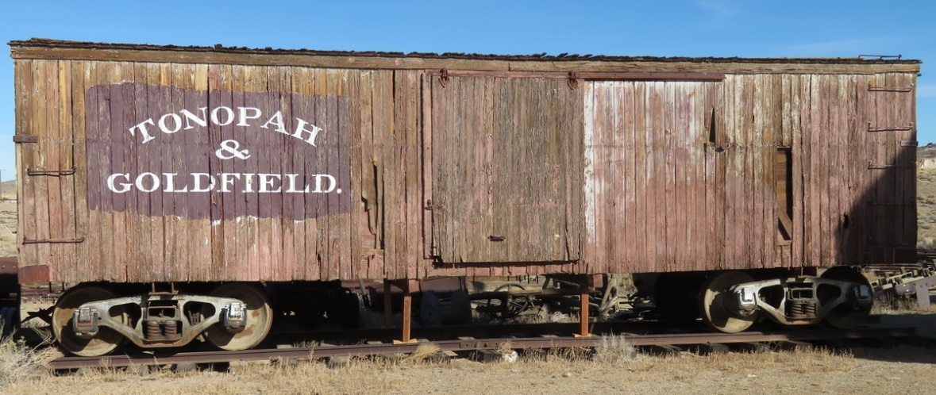
Goldfield Historical Society, Goldfield NV, 2023 Heritage Grants award $4100.00. A steam locomotive plus two former T&G boxcars are on display in the former Bullfrog Goldfield Railroad yard near the Santa Fe Saloon. These are the last known remaining T&G wooden freight cars, and the only known remaining examples of Hicks-built boxcars. They date from 1905. Their preservation is the subject of a recently awarded grant by NRHS to the Goldfield Historical Society.

Slide 11
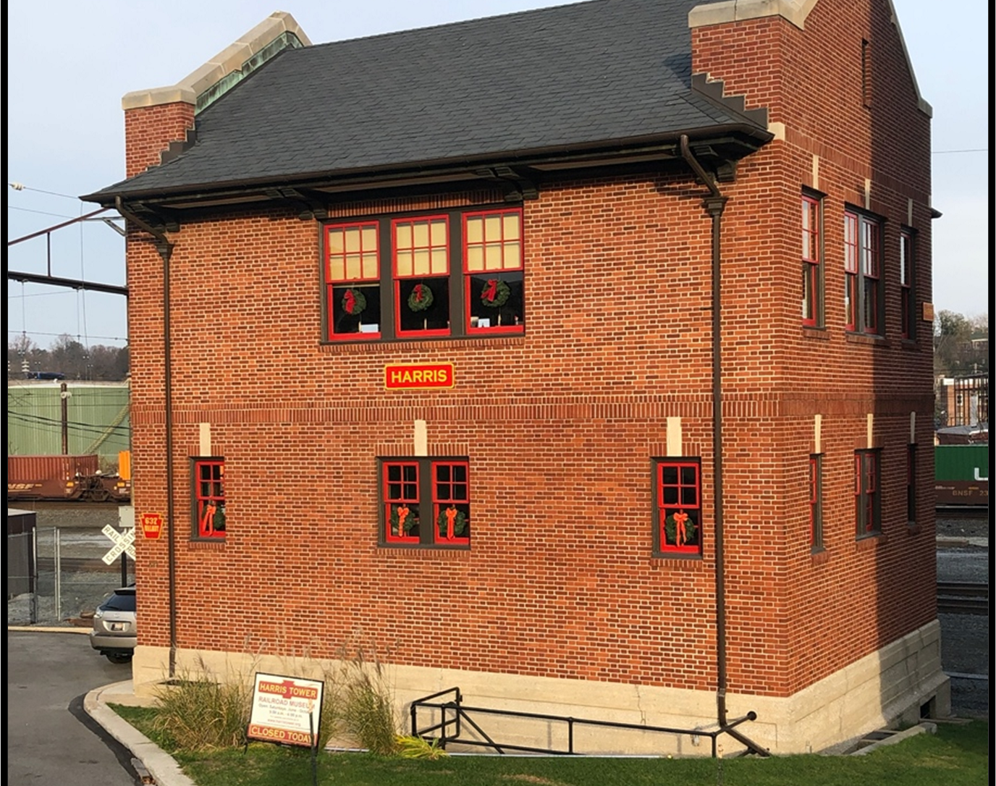
HARRIS Tower Restoration,
2021 Grant
The project began in 2020 with a $2,000 grant from NRHS-National Railway Historical Society.
Chapter members have given another $11,000. The project includes two main areas: cleaning and sealing of the tower exterior, and restoration and repainting of windows and brick mold trim.

Slide 12
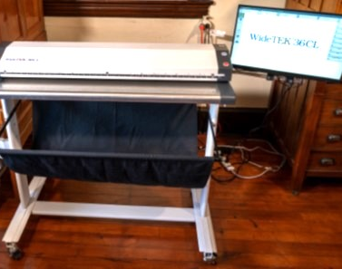
East Broad Top Foundation,
2022 Grant
EXECUTIVE SUMMARY
• The EBT Foundation, Inc. was awarded a 2022 NRHS Heritage Grant for $4,990.00.
• Award funding was used to purchase a WideTEK 36CL MF 36” wide format scanner for the Archives and Special Collections program.
• Since August 2022, the scanner has enabled Archives staff to digitize over 1,000+ maps, drawings, and other oversize collection materials.

Slide 13
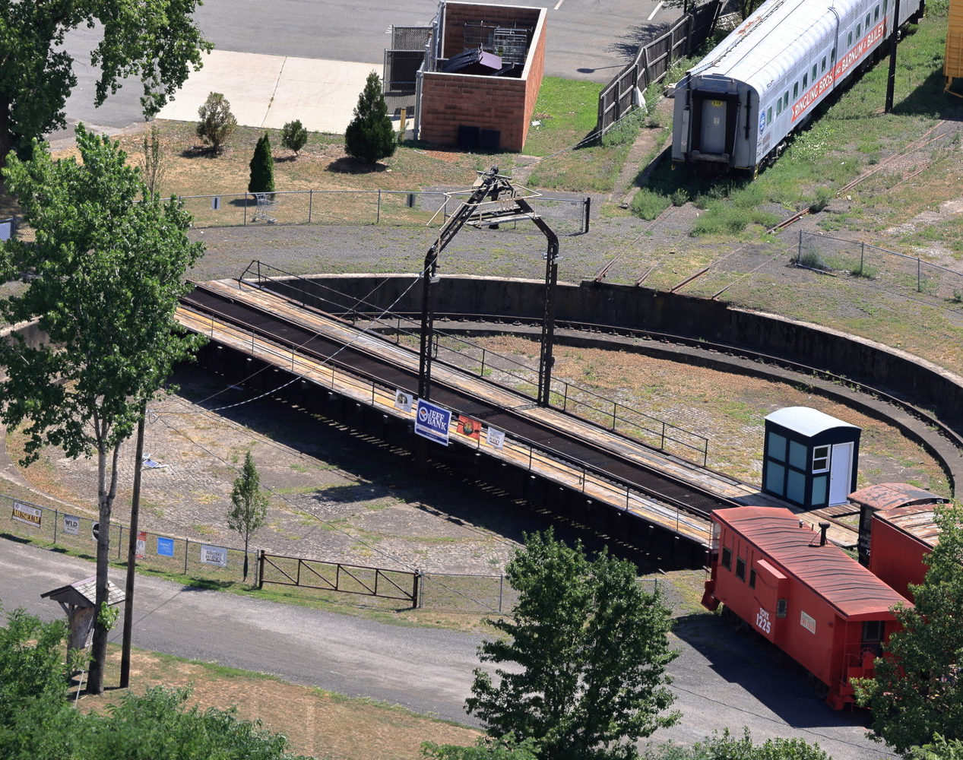
Port Jervis Transportation History Center, Erie Turntable, 2022 Grant
The Port Jervis Transportation History Center (PJTHC) is housed on the former site of the Erie Railroad's Port Jervis engine terminal and roundhouse.
Thanks to a gracious $5,000 grant received from the National Railway Historical Society (NRHS) in late June of 2022, combined with several matching grants and donated services and materials, the PJTHC was able to acquire 1,400 linear feat of custom-cut 3"x10"x10' pressure treated Southern Yellow Pine to fully re-deck the turntable.

Slide 14
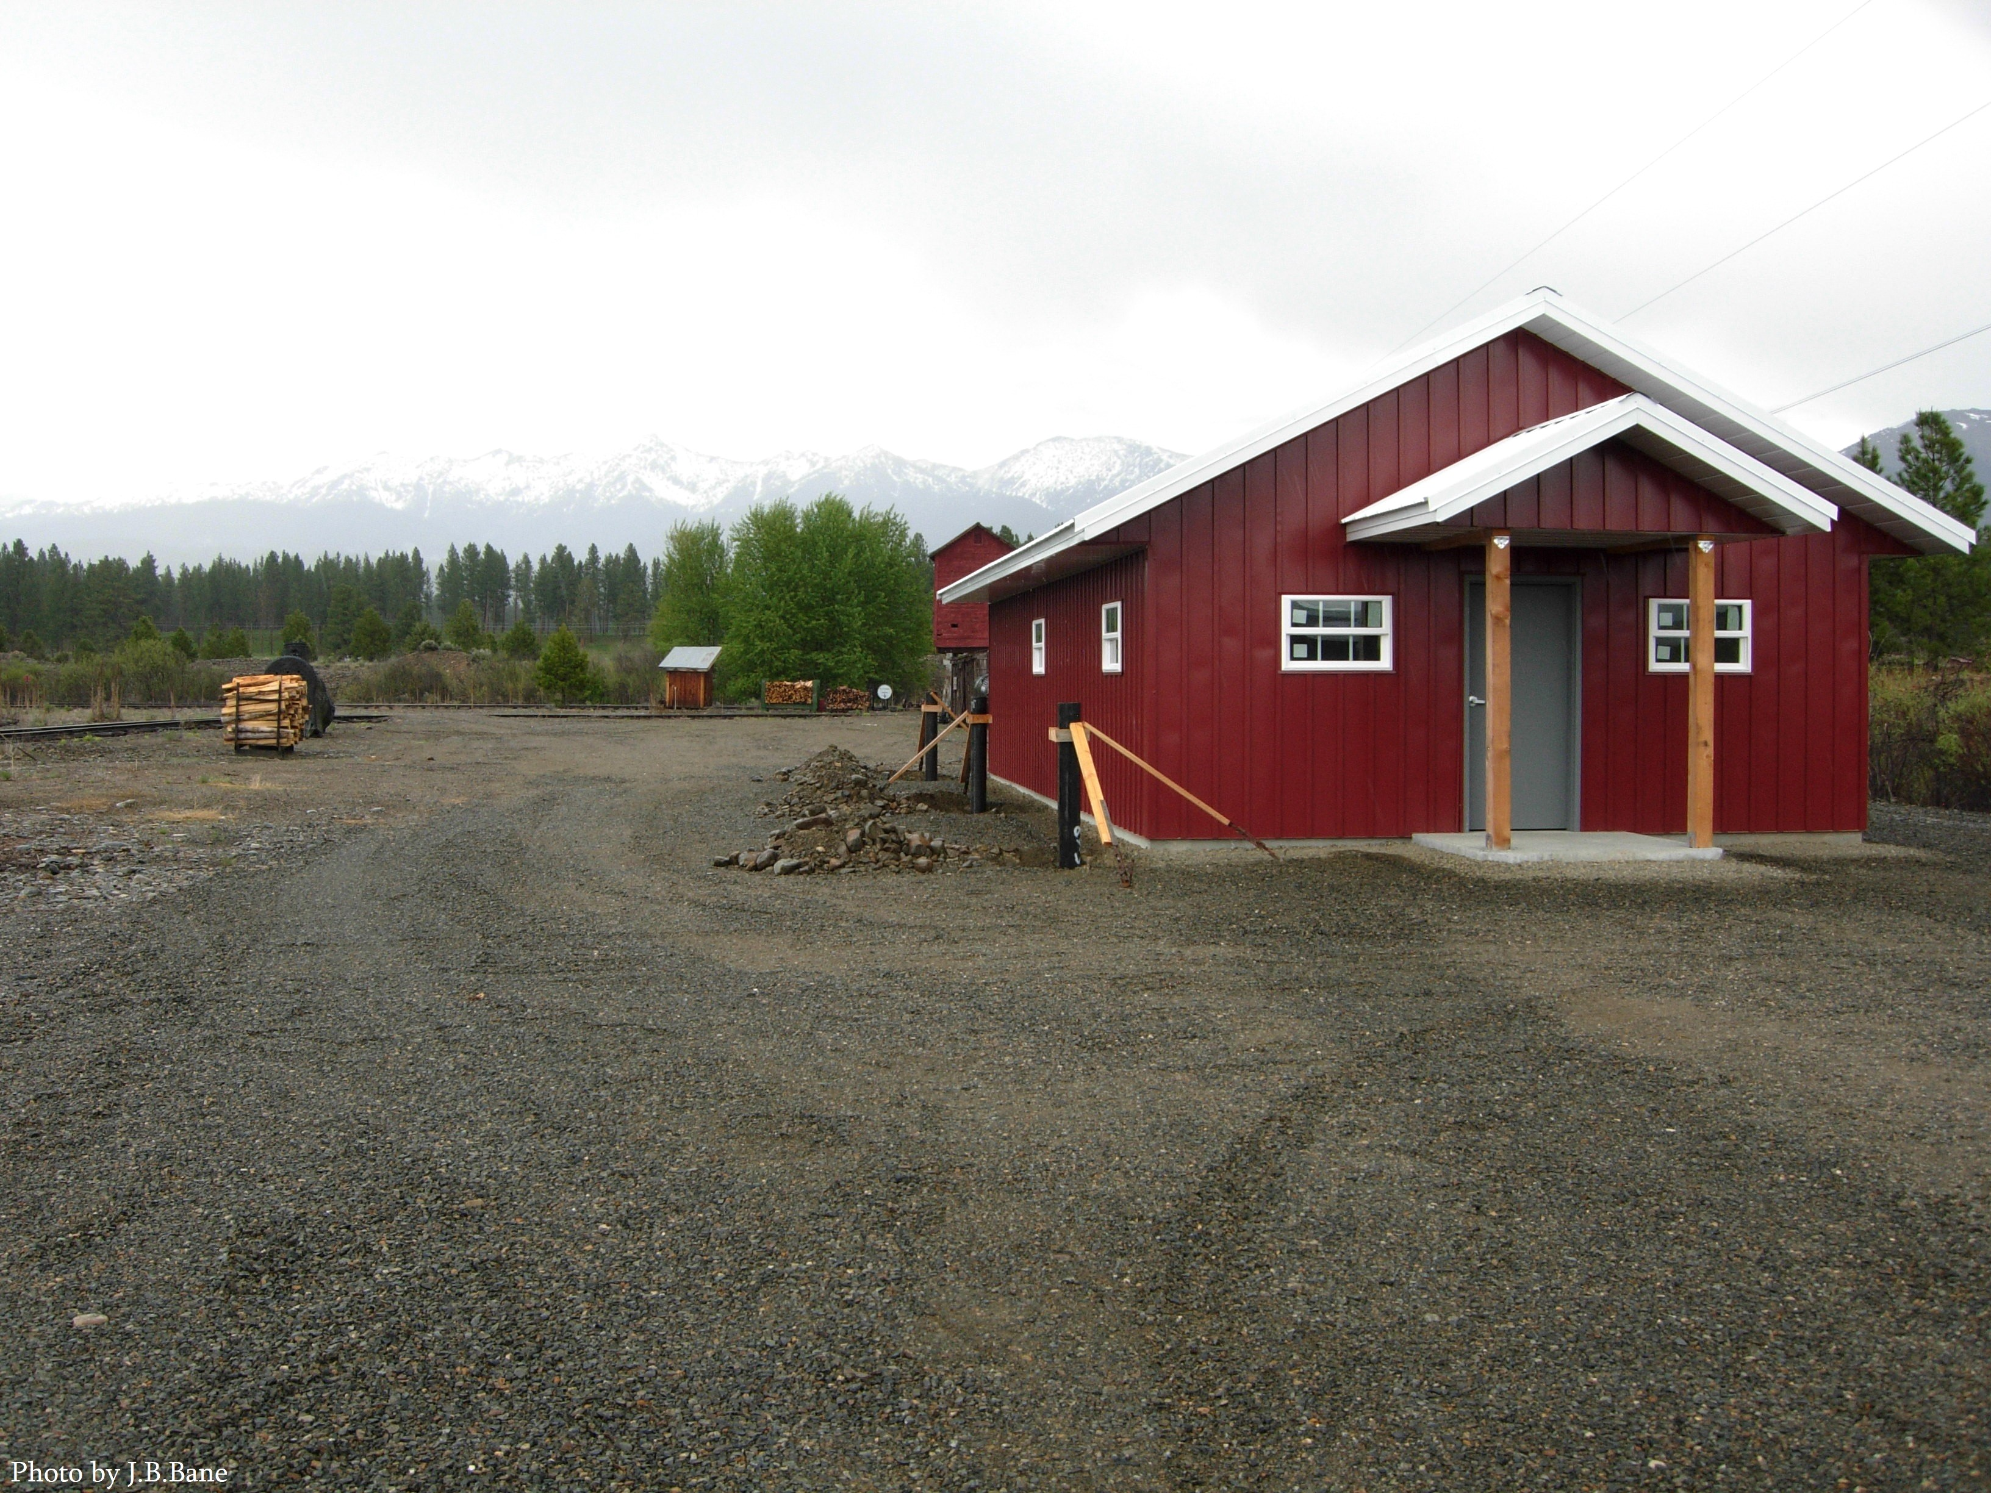
Sumpter Valley Railroad Restoration, 2023 Grant
Sumpter Valley Railroad Restoration, Inc., “SVRR” was awarded a Heritage Grant in 2023 to assist with construction of their new archive and library building. The matching grant was targeted toward the HVAC system for the structure.

Slide 15
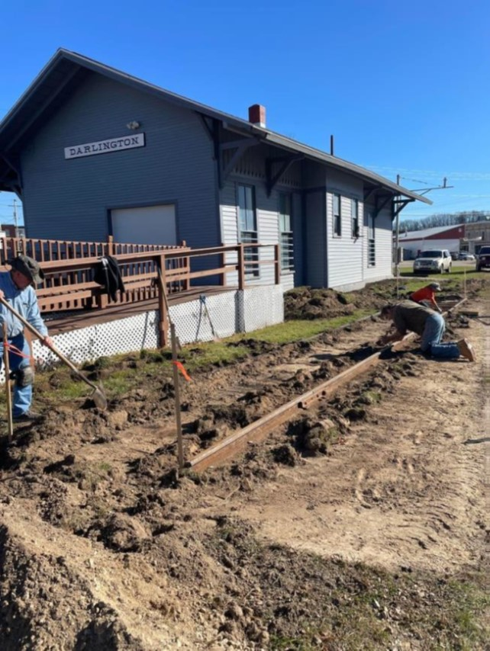
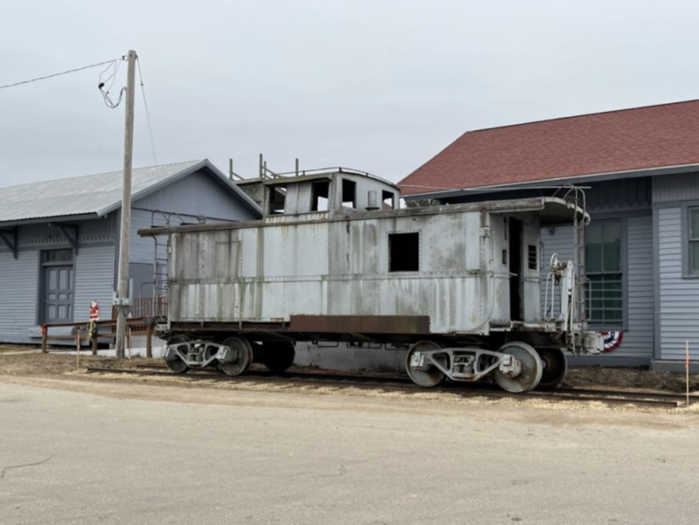
Southwest Wisconsin Chapter – Darlington WI caboose restoration project at the Lafayette County Historical and Genealogy Society. Grant awarded $5,000 – 2024 Grant. New Chapter!!!

Slide 16
Key Dates for 2027 NRHS Heritage Grants.
Applications will be available on the NRHS Website in mid-November.
Deadline will be January 31, 2027 at 8PM Eastern Standard time.

